Slide 1




MI Data Analysis & Visualization

Slide 2
Objective
Analyze the Multiple Intelligence test score data of 257 students.
Visualization of Test Report in an easily understandable format for parents in the form of a dashboard.
Recommendation of possible degrees and careers based on relative performance on 8 different intelligence categories.

Slide 3

DESCRIPTIVE ANALYSIS

Slide 4
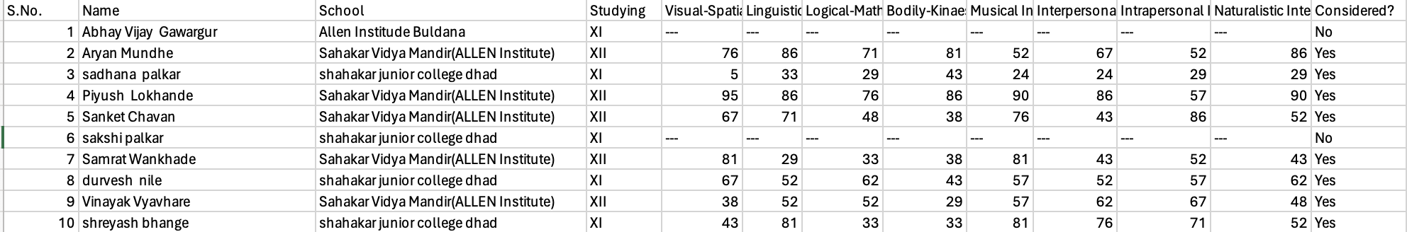
Given Data

Slide 5
Determination of relative performance score bands
Total no. of students |  |  |  | 257 | 257 | 257 | 257 | 257 | 257 | 257 | 257
Median |  |  |  | 67 | 62 | 62 | 57 | 62 | 62 | 62 | 67
Std. Dev |  |  |  | 18.05 | 15.89 | 16.06 | 16.32 | 15.24 | 17.63 | 15.60 | 18.94
0.5SD |  |  |  | 9.03 | 7.95 | 8.03 | 8.16 | 7.62 | 8.82 | 7.80 | 9.47
M-0.5SD |  |  |  | 57.97 | 54.05 | 53.97 | 48.84 | 54.38 | 53.18 | 54.20 | 57.53
M+0.5SD |  |  |  | 76.03 | 69.95 | 70.03 | 65.16 | 69.62 | 70.82 | 69.80 | 76.47
Low Score Median Band |  |  |  | 0 - 57 | 0 - 54 | 0 - 54 | 0 - 49 | 0 - 54 | 0 - 53 | 0 - 54 | 0 - 58
Medium Score Median Band |  |  |  | 58 - 76 | 55 - 70 | 55 - 70 | 50 - 65 | 55 - 70 | 54 - 71 | 55 - 70 | 59 - 76
High Score Median Band |  |  |  | 77 - 100 | 71 - 100 | 71 - 100 | 66 - 100 | 71 - 100 | 72 - 100 | 71 - 100 | 77 - 100
No. of Low Scorers |  |  |  | 85 | 80 | 81 | 92 | 76 | 97 | 96 | 101
No. of Medium Scorers |  |  |  | 99 | 94 | 80 | 78 | 100 | 96 | 84 | 96
No. of High Scorers |  |  |  | 73 | 83 | 96 | 87 | 81 | 64 | 77 | 60
% of Low Scorers |  |  |  | 33.07% | 31.13% | 31.52% | 35.80% | 29.57% | 37.74% | 37.35% | 39.30%
% of Medium Scorers |  |  |  | 38.52% | 36.58% | 31.13% | 30.35% | 38.91% | 37.35% | 32.68% | 37.35%
% of High Scorers |  |  |  | 28.40% | 32.30% | 37.35% | 33.85% | 31.52% | 24.90% | 29.96% | 23.35%

Slide 6
Mapping students to performance bands
Colour | Indication
Green | High Scorers
Yellow | Medium Scorers
Red | Low Scorers

Slide 7

Visualization

Slide 8
Mapping degrees and careers to 8 intelligence
Intelligence Indicative degrees to pursue Indicative careers to pursue
 | Visual-Spatial Intelligence | Design, Music, Engineering, Business | interior designer, graphic designer, fashion designer, artist, engineer, photographer, pilot, sculptor, urban planner, Entrepreneur
 | Linguistic-Verbal Intelligence | Law, Teaching, Mass Communication, Acting, Business | Writer, editor, journalist, lawyer, teacher, historian, politician, poet, actor/actress/Music performer, librarian, translator, radio or TV announcer, Marketeer, Entrepreneur, Manager
 | Logical-Mathematical Intelligence | Engineering, Mathematics, Computer Science, Accountancy, Statistics/ Econometrics, Economics, Physics, Finance, Medicine, Business | Scientist, mathematician, computer programmer, engineer, accountant, data specialist, economist/ statistician, pharmacist, researcher, physicist, auditor, doctor, financial advisor, Manager, Entrepreneur
 | Bodily-Kinaesthetic Intelligence | Sports Management, Dance, Acting, Music, Vocational Skills (e.g. carpentry) | Dancer or choreographer, body builder, athlete or sportsperson, actor, music technician, stage performer
 | Musical Intelligence | Music, Instruments, Singing, Speech Therapy, Data Science, Business | Musician, music teacher, composer, singer, sound editor, recording engineer, music teacher, speech therapist, data scientist
 | Interpersonal Intelligence | Psychology, International Relations, Sales and Marketing, Social Work, Development Economics, Nursing, Tourism, Public Relations, Mediation, Business | Manager, Entrepreneur, Marketeer, Lawyer, Psychologist, philosopher, counsellor, salesperson, politician, diplomat, social worker, coach, teacher, caretaker, travel agent, public mediator, public relations expert
 | Intrapersonal Intelligence | Psychology, Journalism, Language, Science, Management, Business | Philosopher, writer, theorist, scientist, psychologist, criminologist, career counsellor, healer, entrepreneur
 | Naturalistic Intelligence | Environmental Sciences, Astronomy, Meteorology, Culinary, Photography, Veterinary, Communication Design, Business | Environmental Scientist, Biologist, conservationist, landscape designer, astronomer, meteorologist, chef, nature photographer

Slide 9
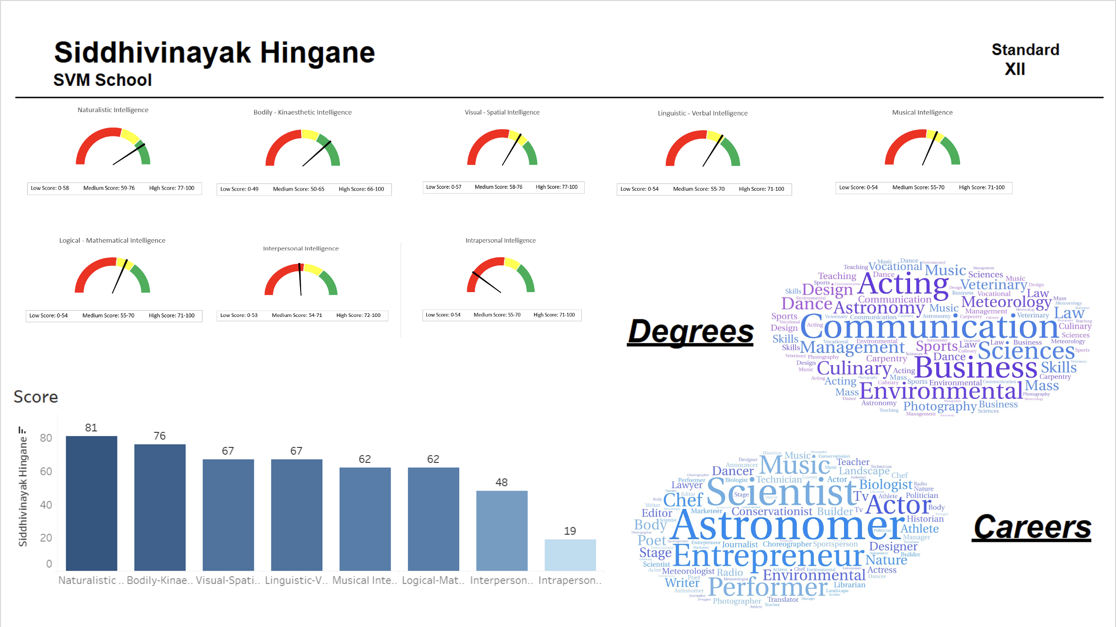

Slide 10
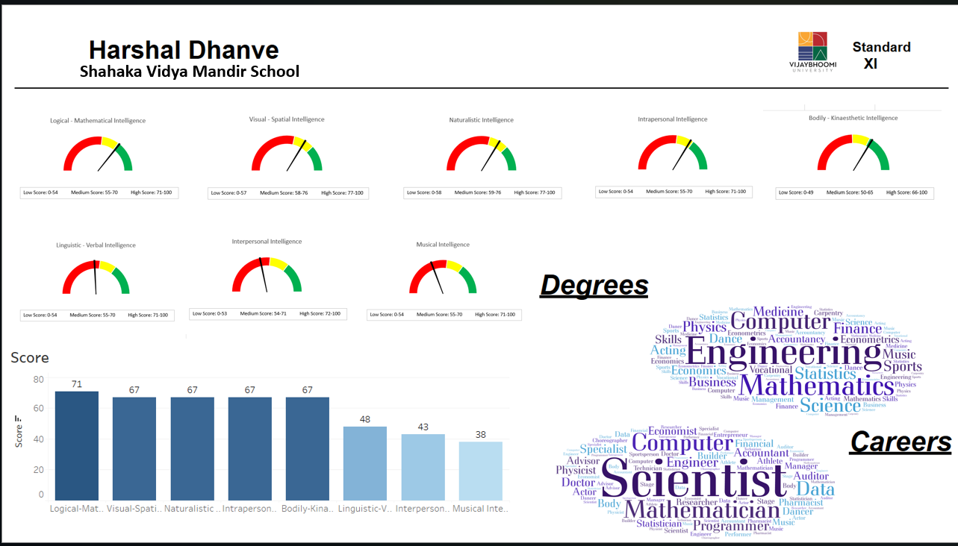

Slide 11
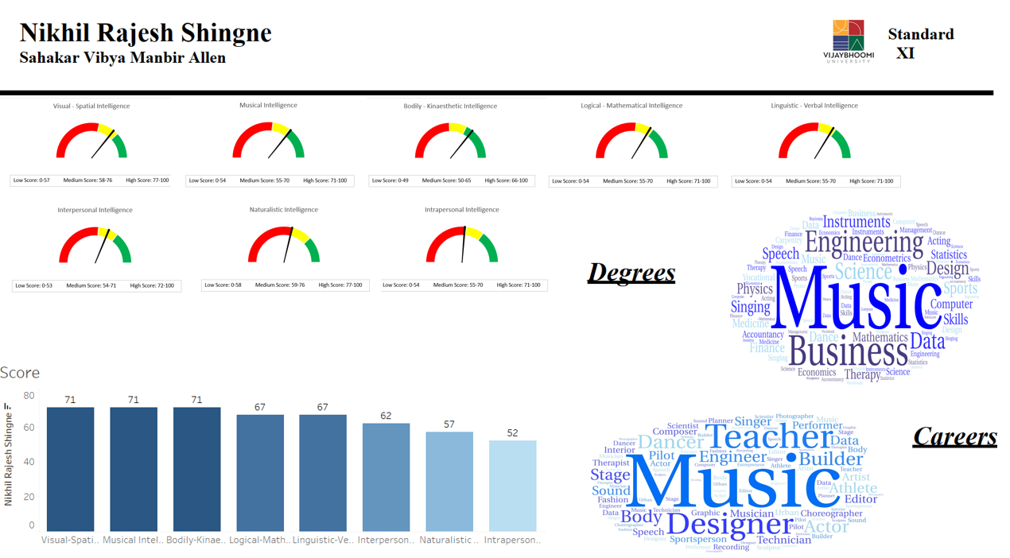

Slide 12

TECHNICAL LEARNINGS
Cleaning of data - Handling missing data. Missing data imputation can not be used here so we removed the missing data. 6 rows were removed for further processing.
Text processing - Making text data uniform and with proper spacing using relevant Excel formulae.
Entity resolution problem.
Learning computation of standard deviations in Excel, creation of bins based on relative performance.
Learning of visualization of data through conditional formatting.
Creation of performance dials (Gauge charts) using Excel
Creation of Word Clouds
Creation of Bar charts in Tableau and overall structure of dashboard

Slide 13
MANAGEMENT LEARNINGS
Generation of alternatives and choosing the best one.
Started with small team and scaled up to a bigger team.
Quality checks at the end to ensure uniformity and correctness of information from all team members.
Working under pressure while managing time to meet deadlines.

Slide 14

Thank you

